Slide 1
GE8151 Problem Solving and Python Programming
Rajasekaran S
Assistant Professor,
Department of Information Technology,
KGiSL Institute of Technology,
email: proffraja@gmail.com
Github:www.github.com/rajasekaranap

Slide 2
Functions Types [Arguments Based]
Based on the arguments passed functions classified into three types.
Default arguments.
Keyword arguments.
Arbitrary arguments.

Slide 3
Default Arguments
Default arguments accepts a default values.
If no value is provided in the function call for that argument.
The default value can be provided to the default argument using assignment operator(=).

Slide 4
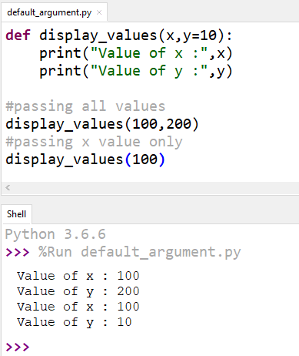
Example
Default Argument
Value Passed for y
Value not passed for y
Y = 200
Y = 10 [Default Value Taken]

Slide 5
Keyword Argument
When we create functions with multiple parameters and need to pass arguments for few of them then we can use keyword arguments.
Arguments are identified by the parameter names.
Even we shuffle arguments it will be taken based on parameter names.

Slide 6
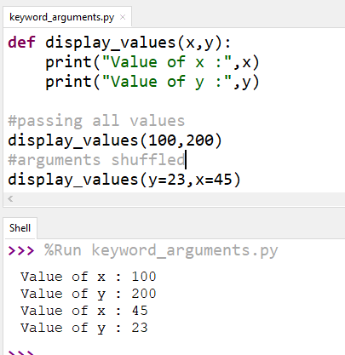
Example
Keyword arguments

Slide 7
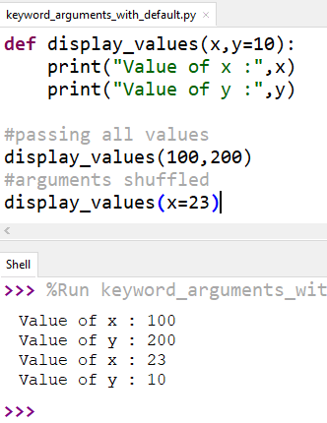
Example [with default argument]
Default
Keyword arguments

Slide 8
Arbitrary Arguments
When not sure about number arguments will be passed then we can use arbitrary arguments.
In function the arbitrary argument is represented with * in front of them.
All the arguments received as tuple.
Tuple will be processed with loops for getting arguments values.

Slide 9
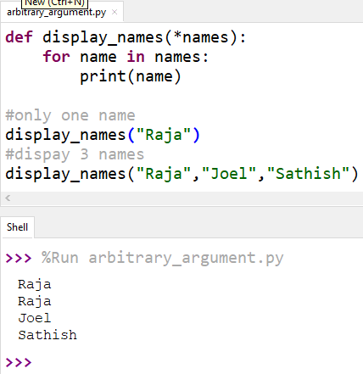
Example
One name
Three names

Slide 10
Thank You
Rajasekaran S
Assistant Professor,
Department of Information Technology,
KGiSL Institute of Technology,
email: proffraja@gmail.com
Github:www.github.com/rajasekaranap

